Slide 1

Code Refactoring and Bug Fixing
Shraddha Kalaskar

Slide 2
Agenda :
Refactoring the existing codebase and ensuring the proper functioning of the Note Taking Application.
The goal is to fix the existing codebase and make the application work as intended

Slide 3
Bugs in the given code:
The method name is incorrect in the route :
I have fixed this problem by changing it with POST, and GET methods:

Slide 4
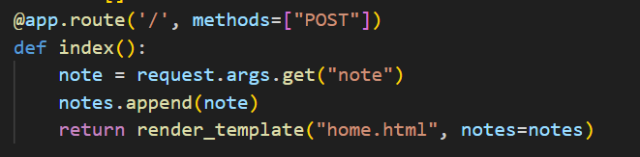
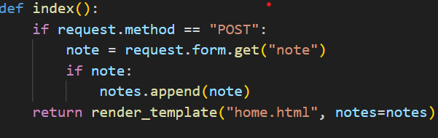
Incorrect Request Method in Index Function :
Sol. : Updated the index function to check for the requests method and handle both GET and POST methods.

Slide 5

Inconsistent use of request args.
It should be
Missing type attribute in Submit Button
It should be :

Slide 6
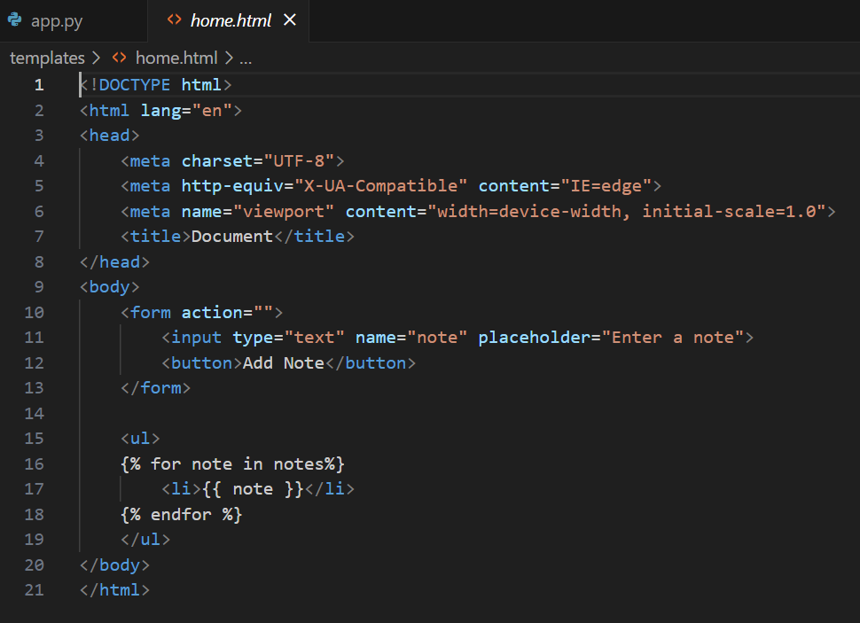
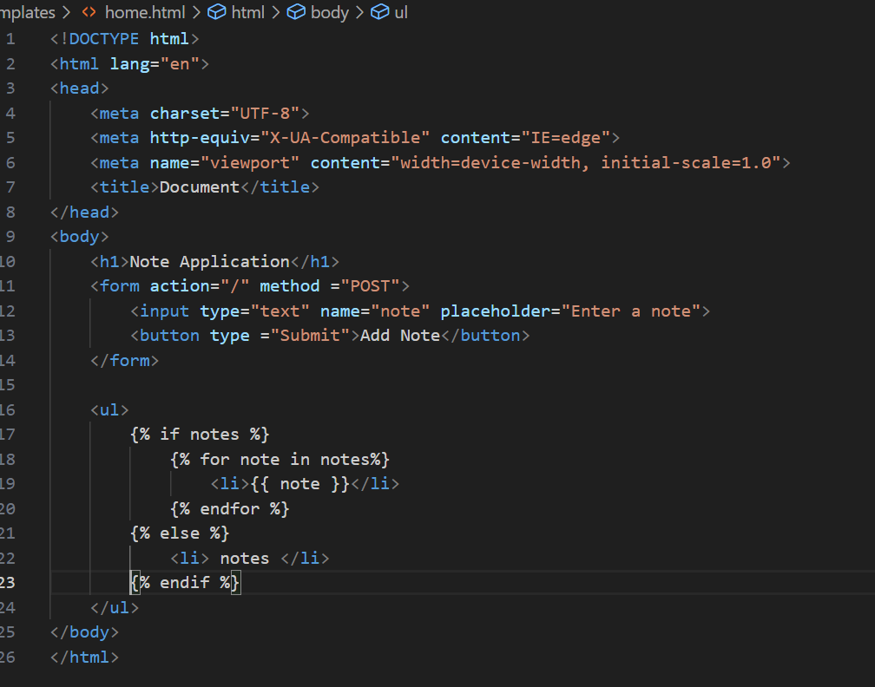
HTML Snippet :
Before BUG Fixing
After BUG Fixing

Slide 7
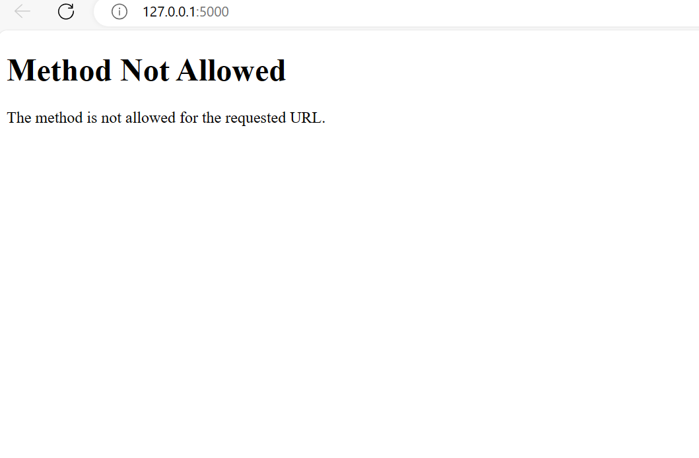
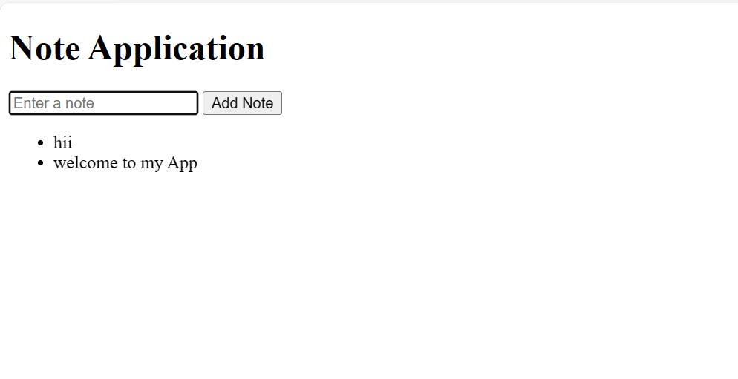
Before Bug Fixing:
After Bug Fixing :

Slide 8

THANK YOU

